Slide 1


Chap
FruitSpiral
Created by Chap Research
total development time
~90 hours (324,000 seconds)

Slide 2
Chap
FruitSpiral
Created by Chap Research
total development time
~90 hours (324,001 seconds)

Slide 3
Chap
FruitSpiral
Created by Chap Research
total development time
~90 hours (324,002 seconds)

Slide 4
Chap
FruitSpiral
Created by Chap Research
total development time
~90 hours (324,003 seconds)

Slide 5
Chap
FruitSpiral
Created by Chap Research
total development time
~90 hours (324,004 seconds)

Slide 6
Chap
FruitSpiral
Created by Chap Research
total development time
~90 hours (324,005 seconds)

Slide 7
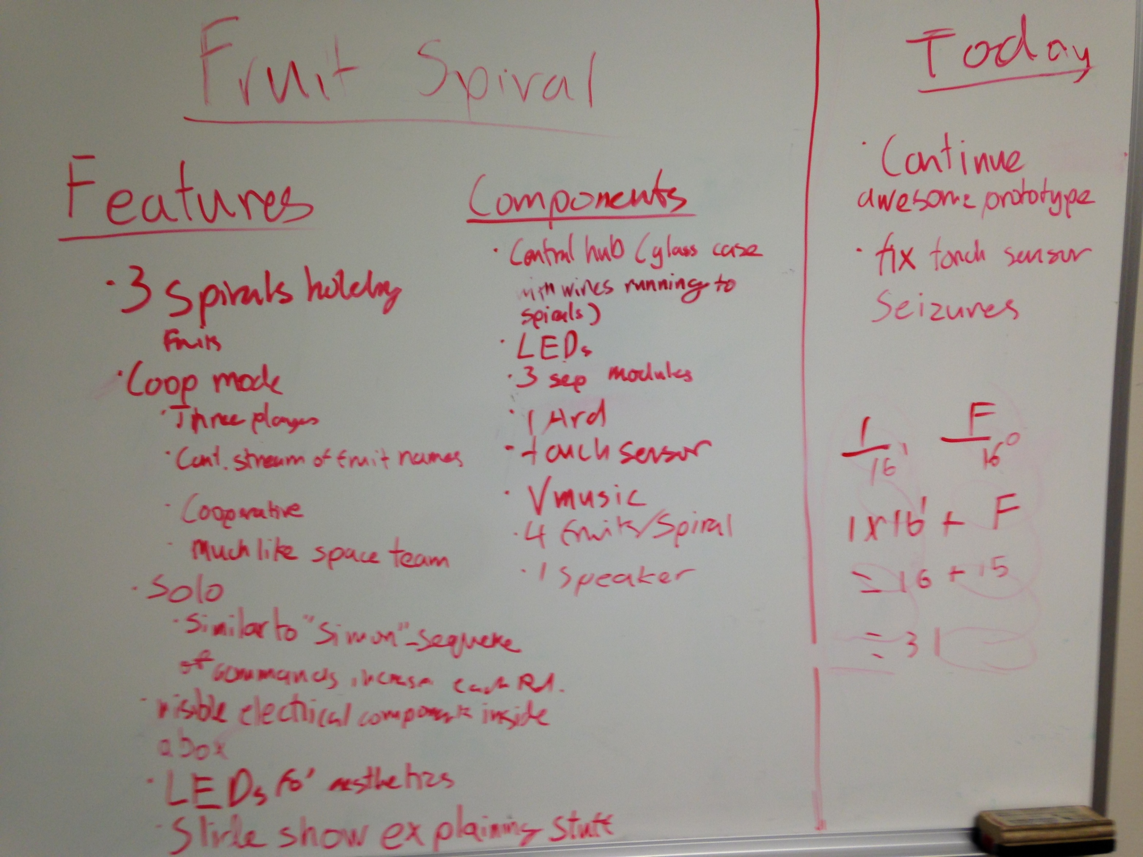
Brainstorming

Slide 8
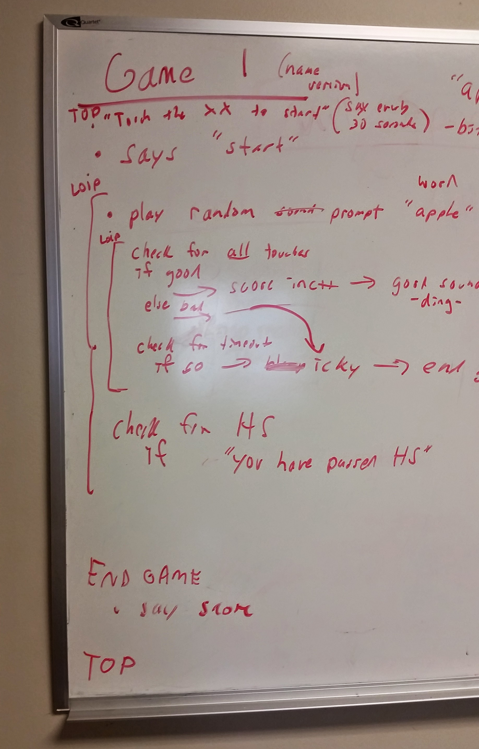
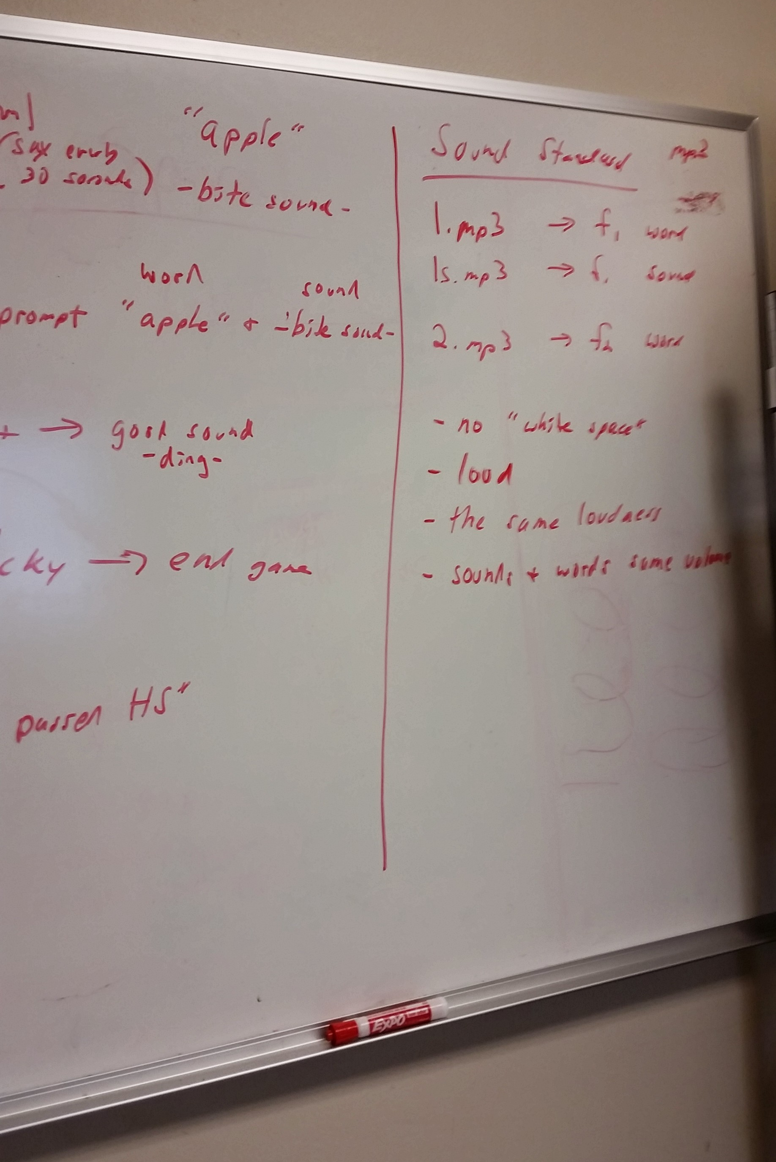
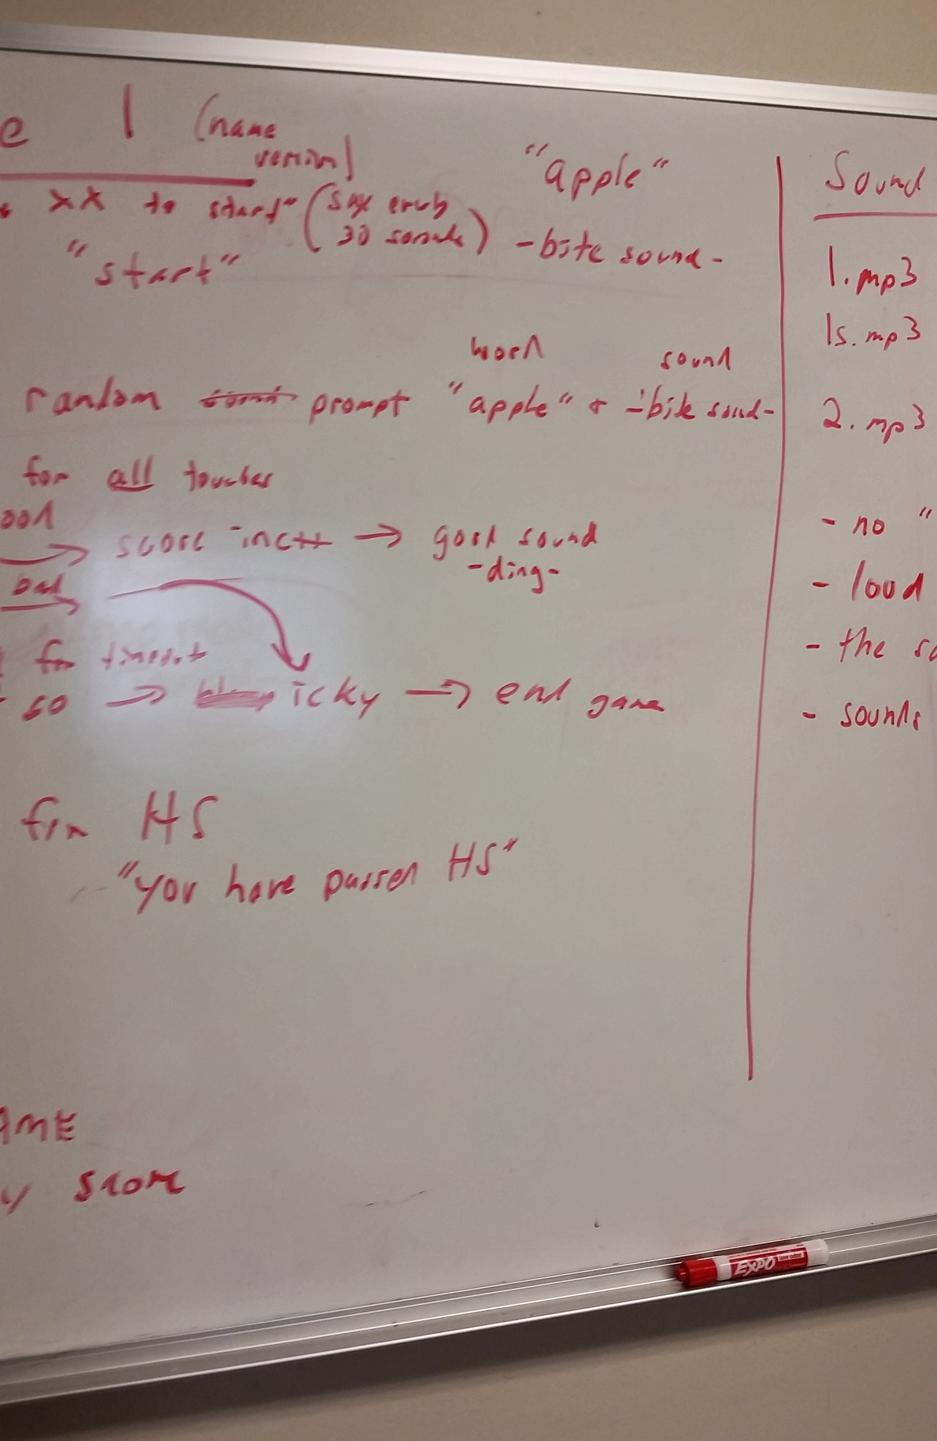
Software
planning

Slide 9
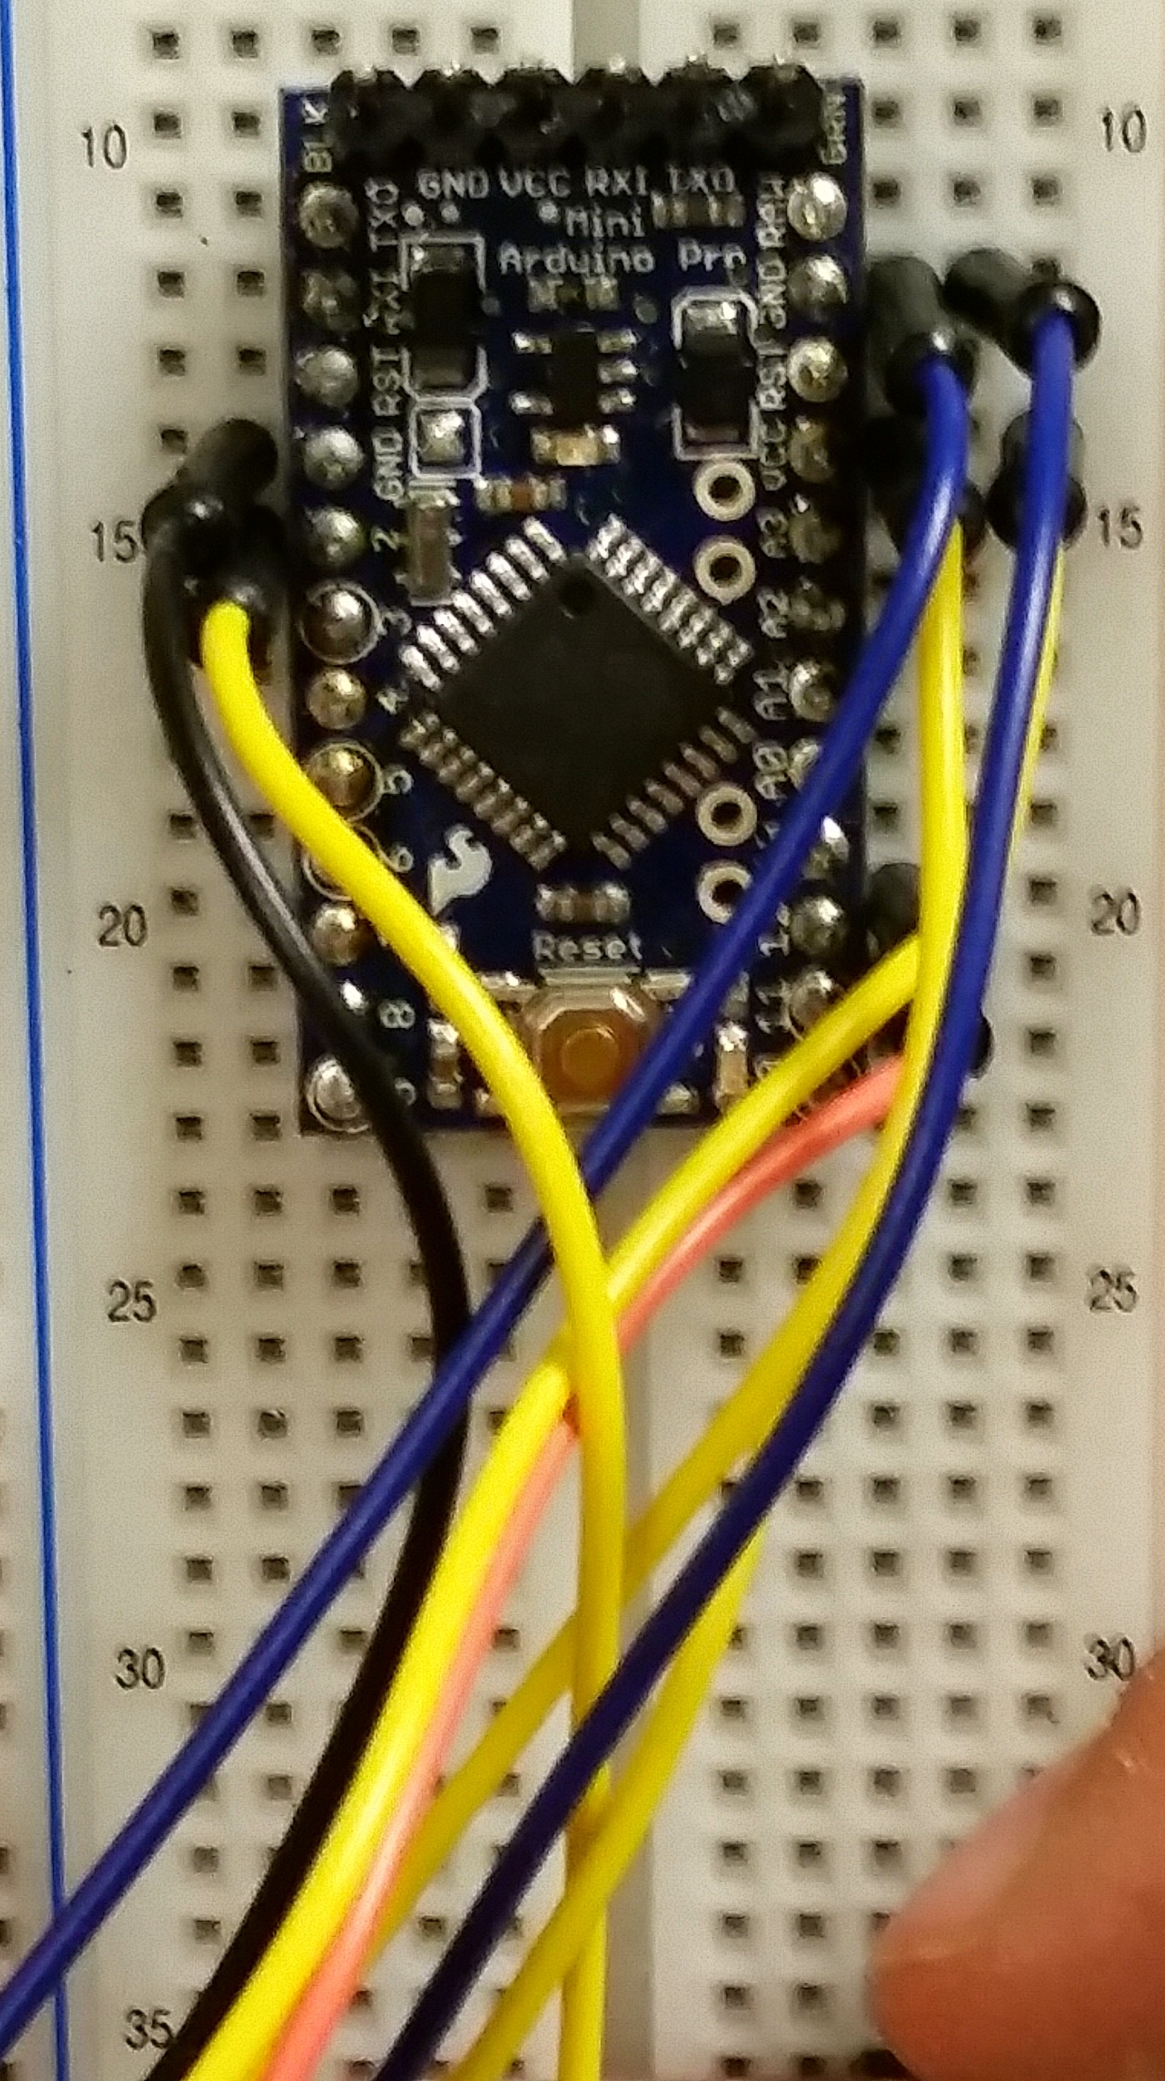
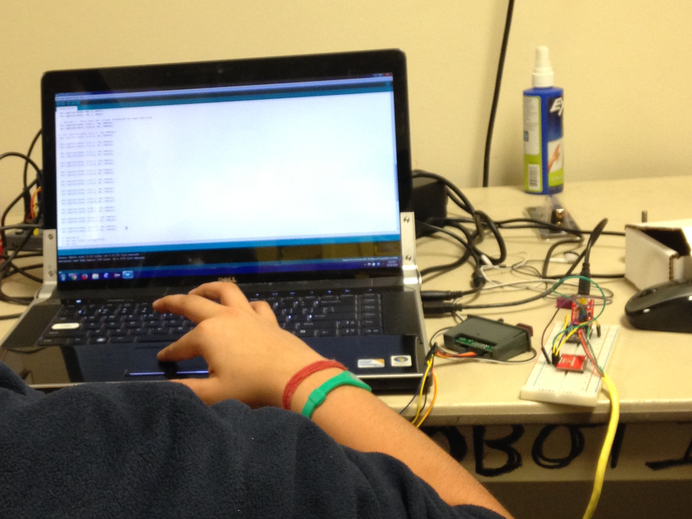
initial prototype
the Arduino
pro mini
We started with a bread board to start testing code, and wired all inputs/outputs to the touch sensor and Vmusic.

Slide 10
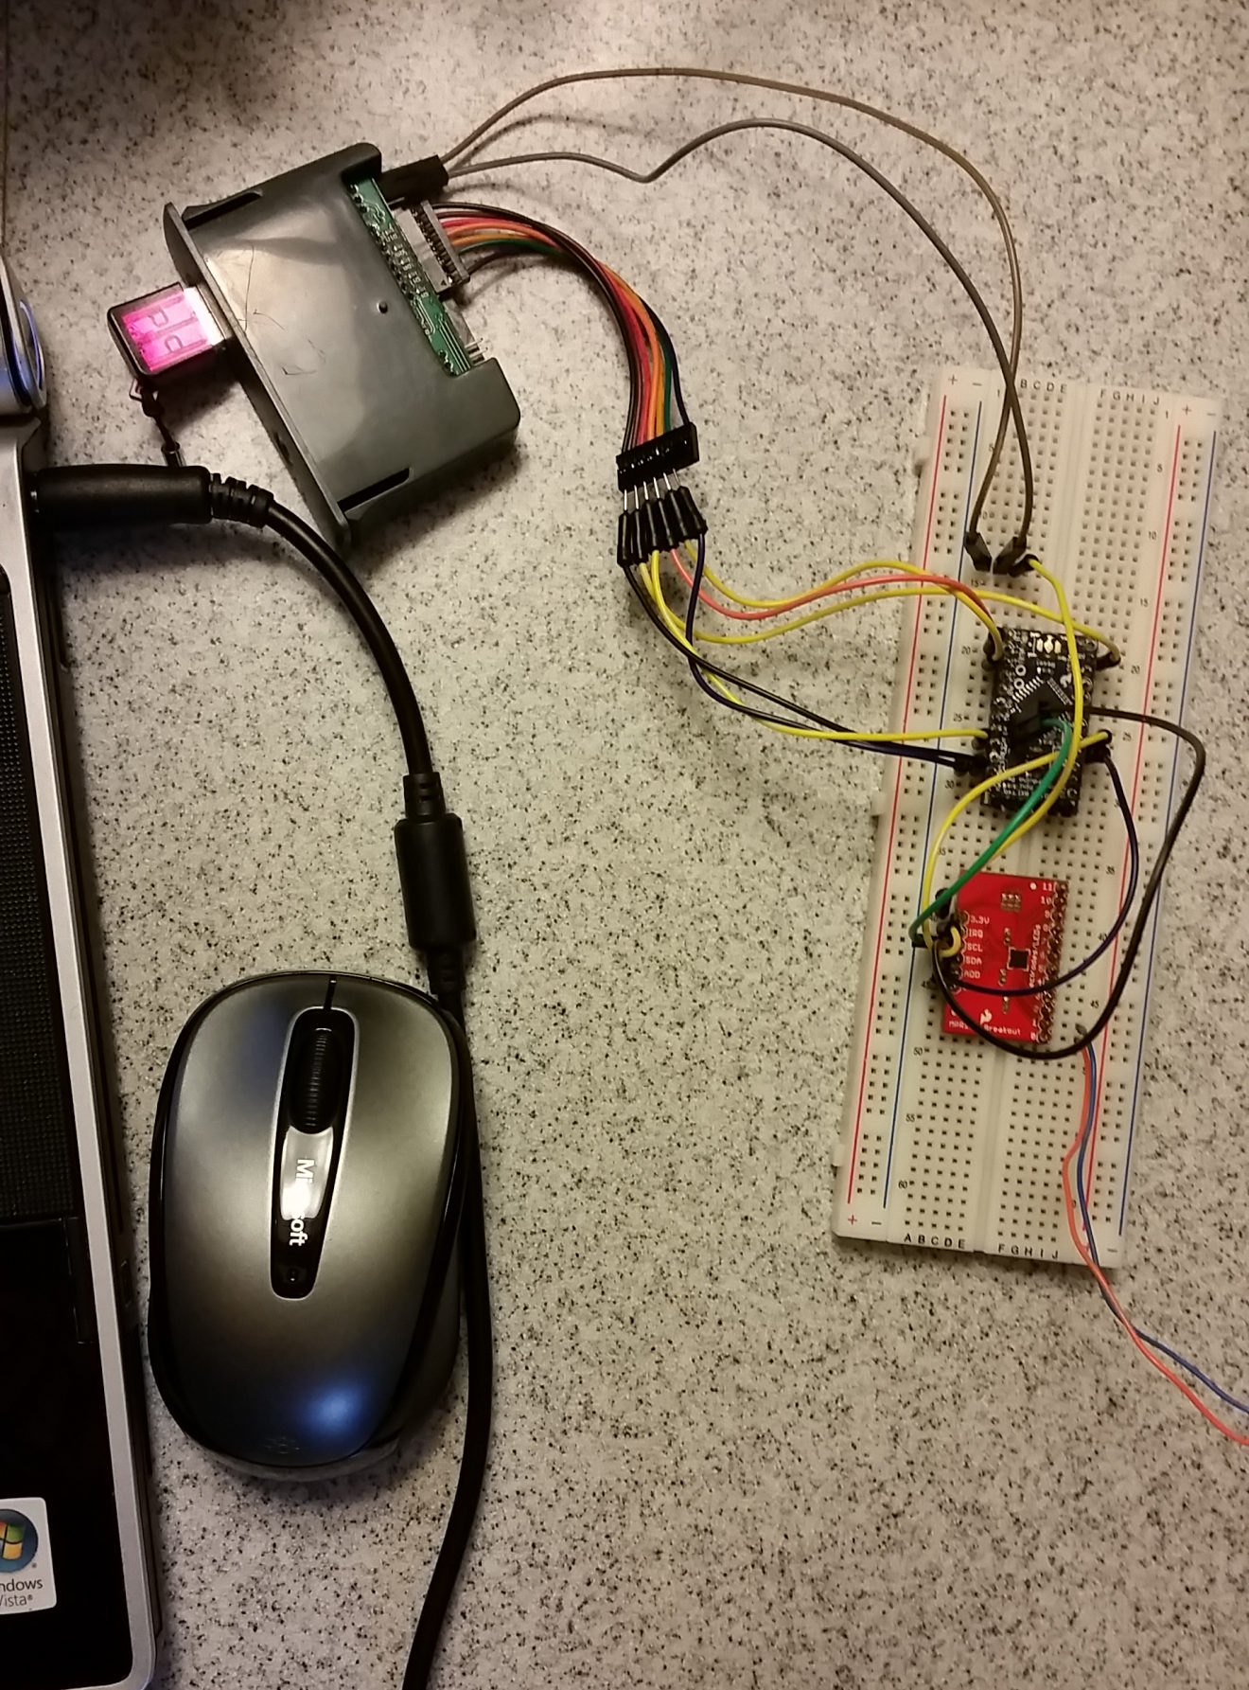
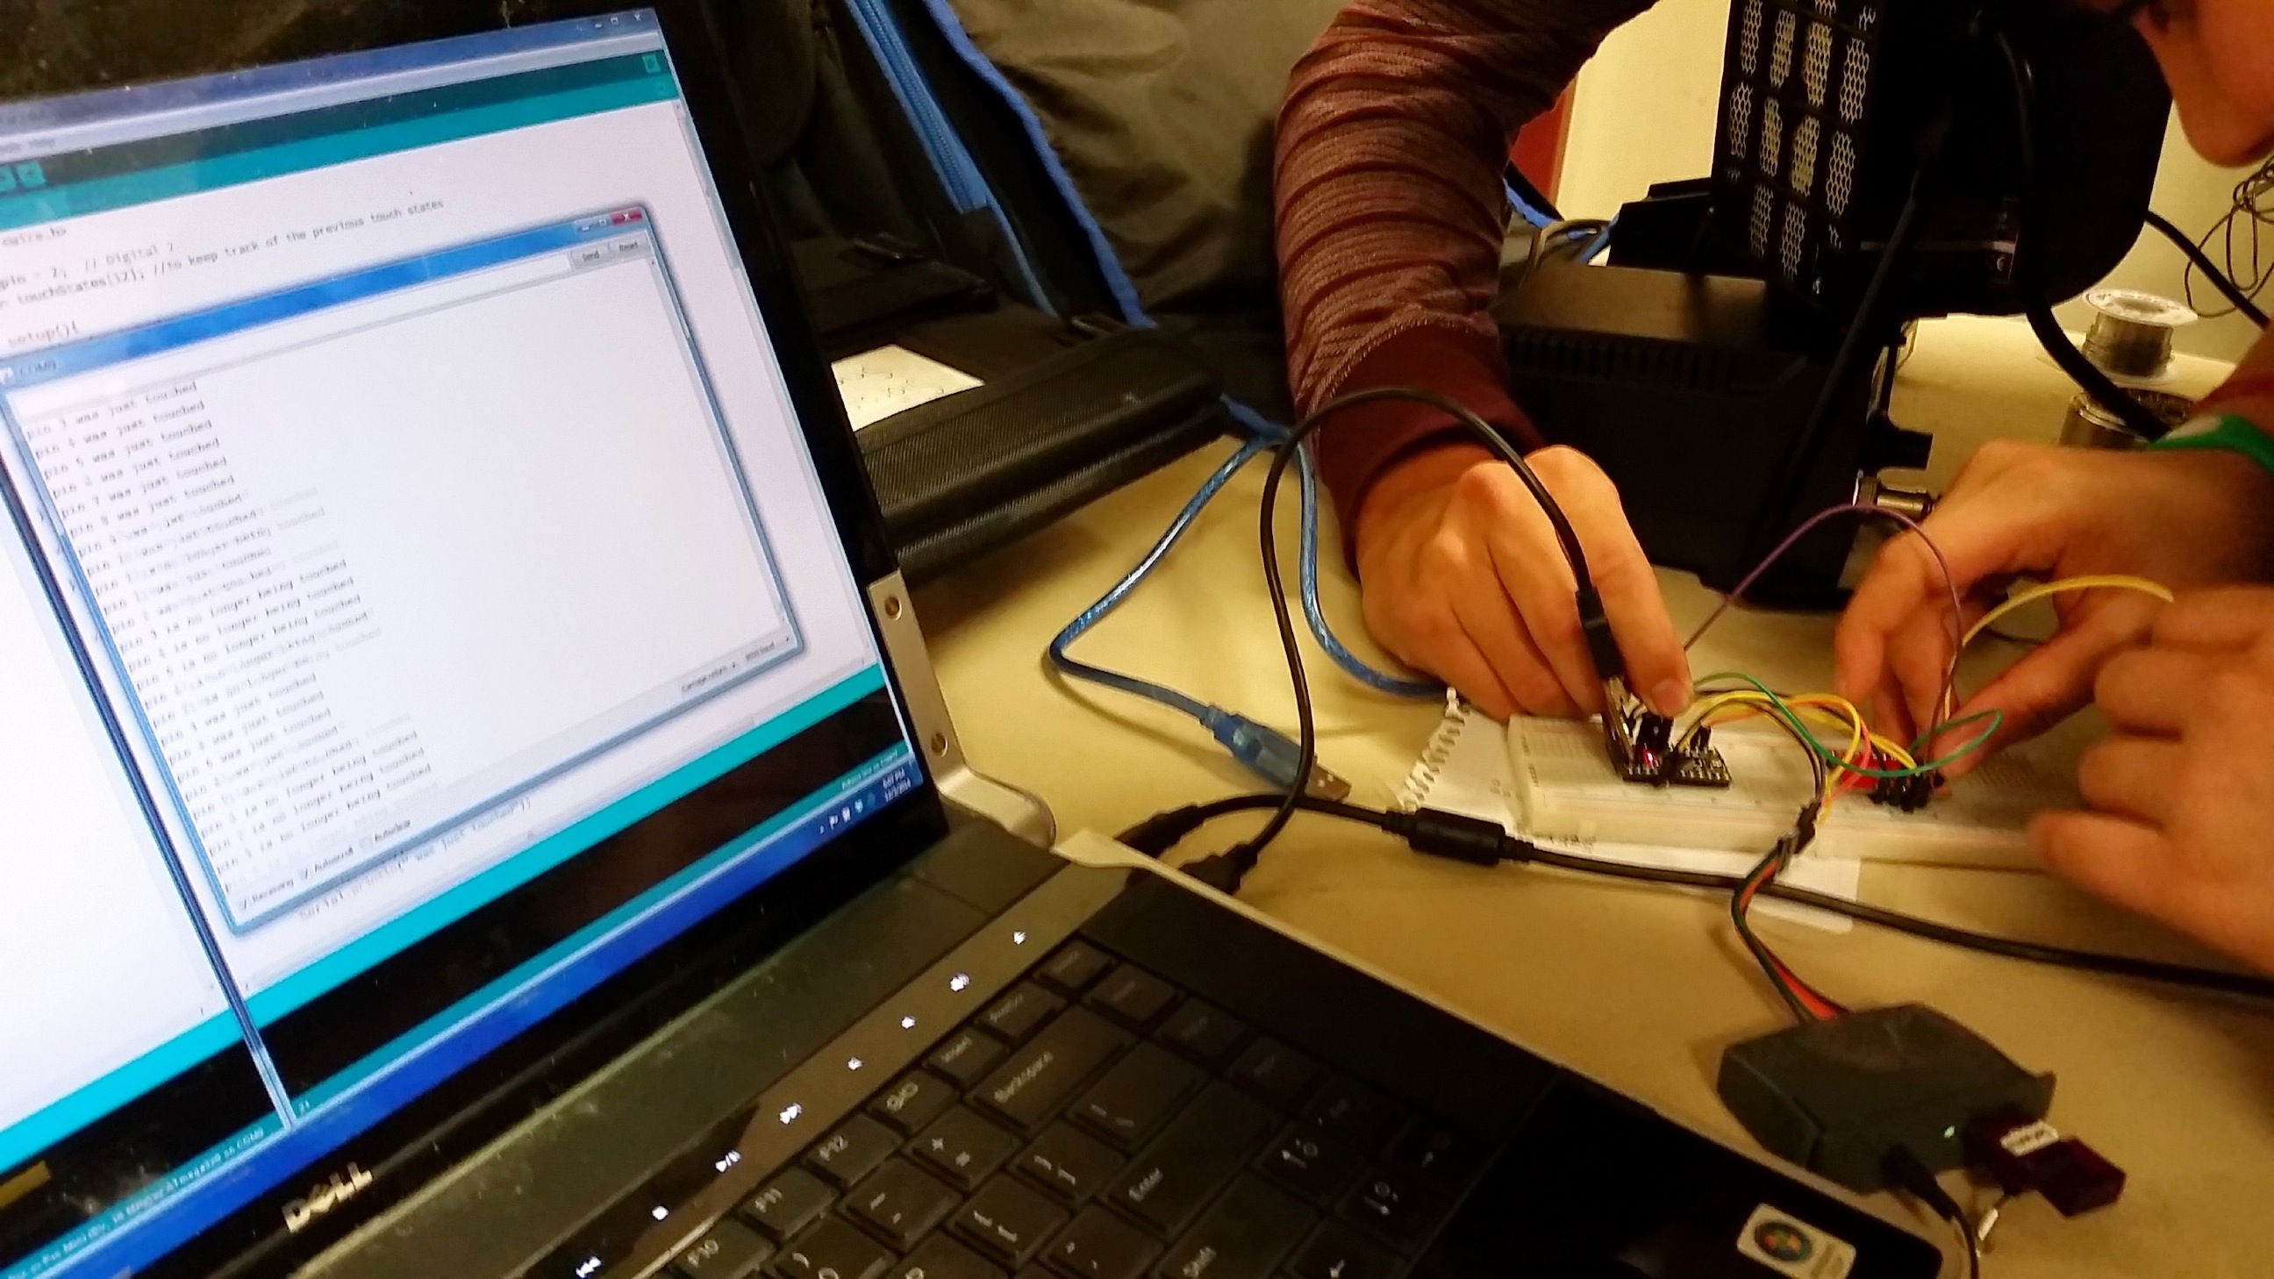
mpr121
Touch Sensor
Board
This was our initial wiring setup, with the Arduino, touch sensor board, and Vmusic.
VMusic
to output
sound
initial prototype
wiring the Arduino,
vmusic, and touch sensor

Slide 11
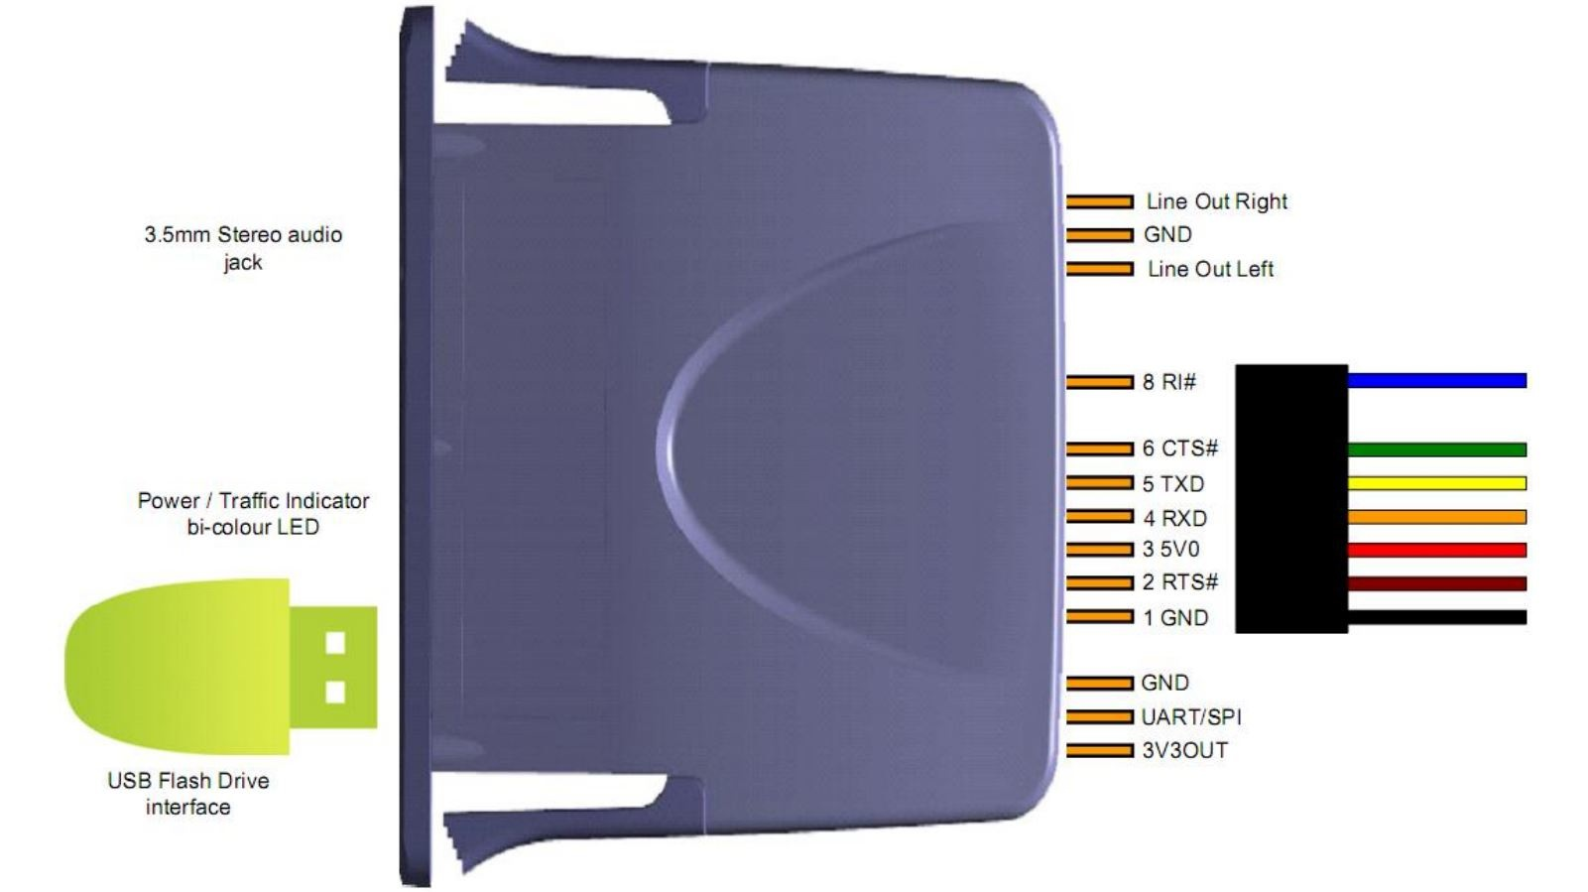
the Vmusic 3
This shows how we connected to the Vmusic to output sound, mainly using the numbered pins to send data.

Slide 12
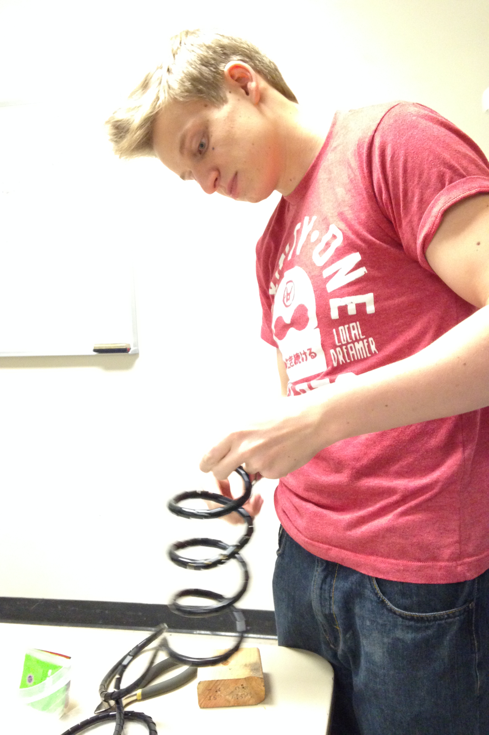
initial prototype
assembling
the spiral

Slide 13
hardware
The FruitSpiral was made by wrapping around a PVC pipe, hand adjusted to suit individual fruits.
The FruitSpiral was wrapped in sheathing to prevent shorts/change in capacitance.
Each FruitSpiral was mounted to the circuit board by inserting into a hole on the side as well as being stapled to the board on top.

Slide 14
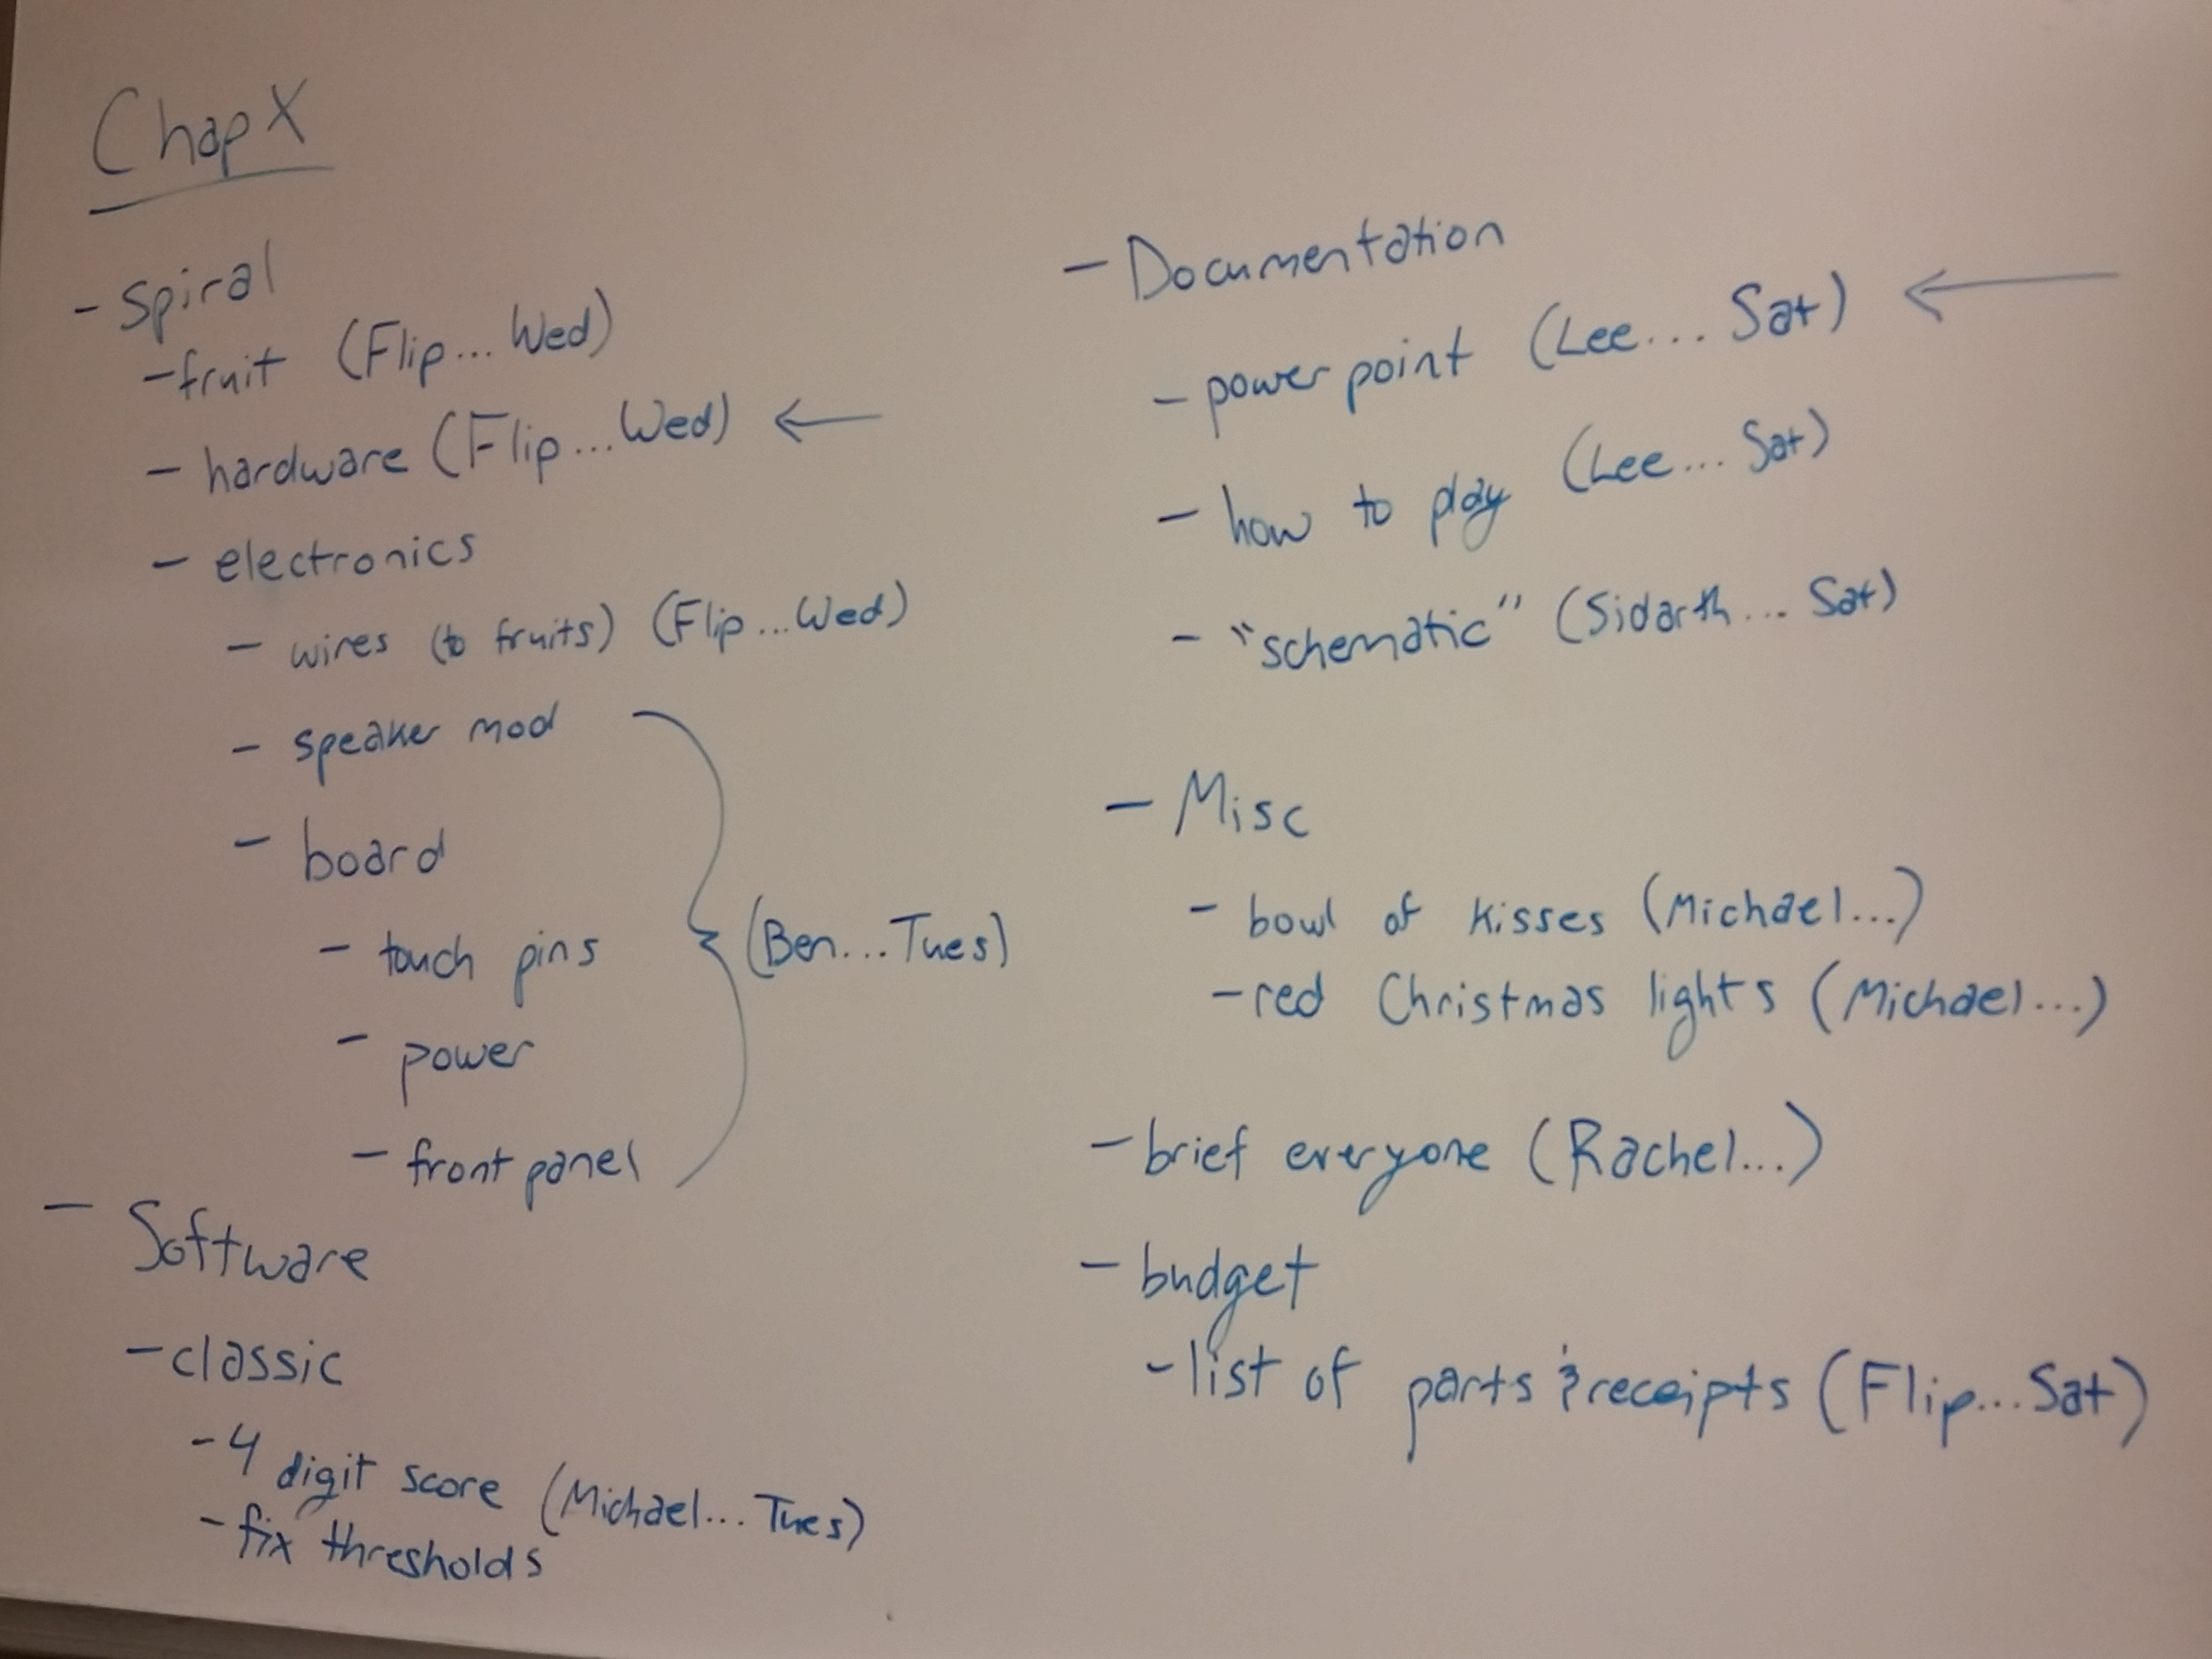
from prototype to final design
tasks

Slide 15
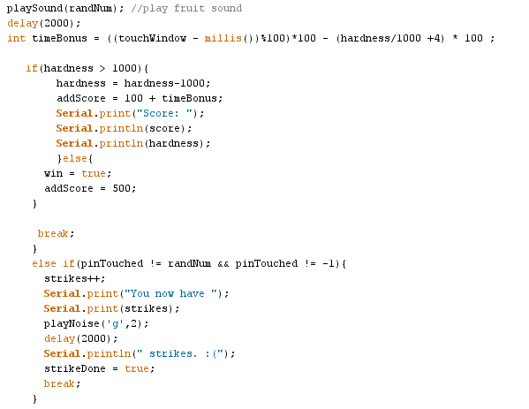
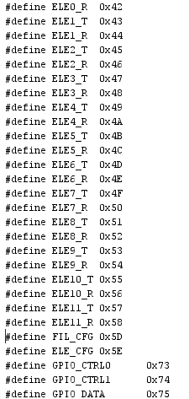
fruitspiral
code

Slide 16
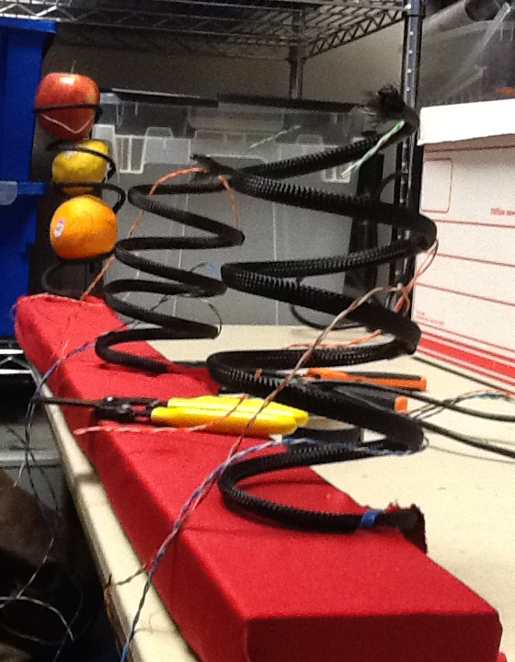
fruitspiral
hardware
Modified sheathing to something nicer
Added support board
Wired spirals to Arduino

Slide 17
the board
The Arduino is wired to a Touch Sensor Board and a Vmusic, which is wired to external speakers. The Arduino gets information about capacitance changes from the Touch Sensor Board, and can tell the Vmusic to play a specific sound file from a USB. The Vmusic then sends the sound to external speakers that can play louder sounds.

Slide 18
software flowchart - classic
prompt user to begin play
check for lose or win
if so
if not
generate random fruit and prompt user
case 1
apple touched
classic mode
wait for input
correct
timeout
play score
incorrect
add to score,
play good sound
subtract from score, add strike, play bad sound

Slide 19
software flowchart - piano
done playing?
prompt user to begin play
if so
case 2
lemon touched
piano mode
if not
wait for input
banana
apple
others
play corresponding sound

Slide 20

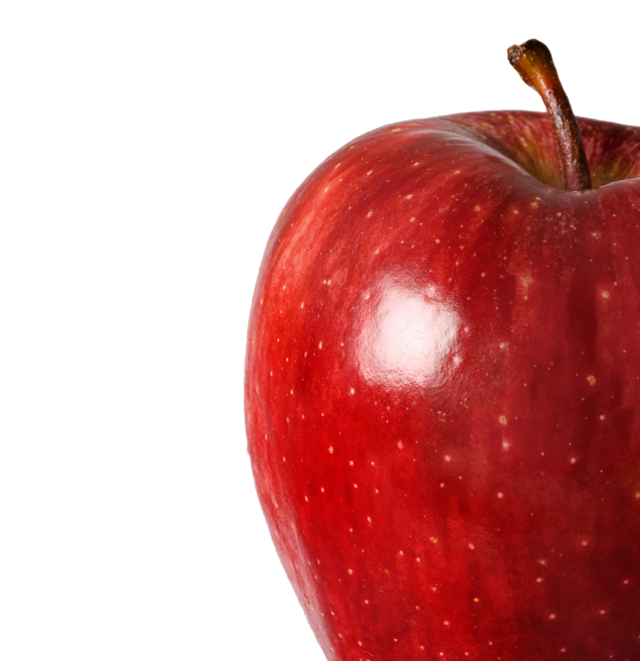
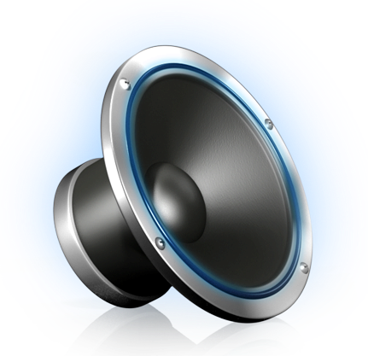
the game: the overview
1 of 3
To interact with the FruitSpiral, simply touch the fruit prompted by the speaker. Currently, there are two modes of the game: Classic and Piano.
APPLE!

Slide 21
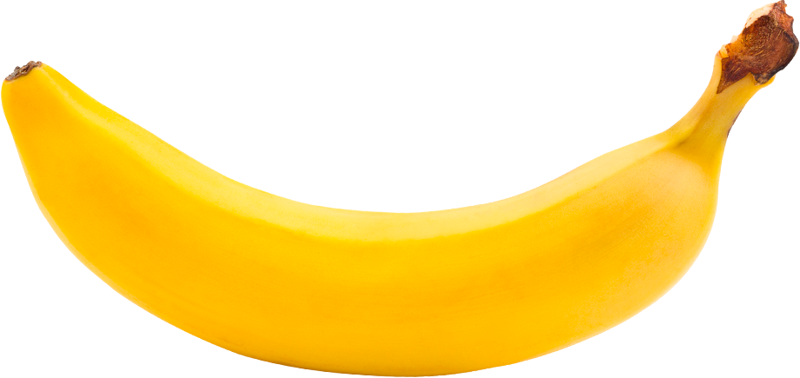


the game: Classic Mode
2 of 3
In Classic mode, the FruitSpiral functions similar to that of a Bop-It game. Users touch the fruit prompted before time runs out to gain points until they incur four strikes.
+

Slide 22


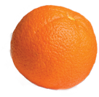
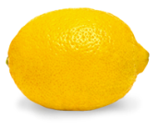
the game: piano Mode
3 of 3
In Piano mode, the FruitSpiral acts like a piano in that users can touch any fruit they choose to produce a sound on the speaker. Each fruit corresponds to a different tone that plays.

Slide 23
About Chap research
1 of 3
Chap Research is an innovation program to give Westlake students the opportunity to learn real world technical and leadership skills not taught in school. It was created to provide students with an opportunity to experience and participate in research and design, giving them the experience and confidence to succeed in college and career settings.

Slide 24
About Chap research
2 of 3
The close connection with industry helps link students to mentors in the community to inspire and support their development. The various projects undertaken by the program allow students to further explore/develop industry-applicable and entrepreneurial skills not taught in school, including management and patent application.

Slide 25
About Chap research
3 of 3
They can then develop portfolios by receiving patents, publication, press coverage and the like for their skill and dedication. Chap Research also hopes to serve as a model and inspiration for similar innovation programs at the high school level.

